Slide 1
Transportation Resiliency, Accessibility and Climate Sustainability (TRACS) Workshop for Transportation Professionals
WORLD INSTITUTE ON DISABILITY AND
METROPOLITAN TRANSPORTATION COMMISSION
SUPPORTED BY
CALIFORNIA DEPARTMENT OF TRANSPORTATION
ENSURING ACCESS IS EVERYONE’S JOB
Workshop for Transportation Professionals
FEB 3, 2021

Slide 2
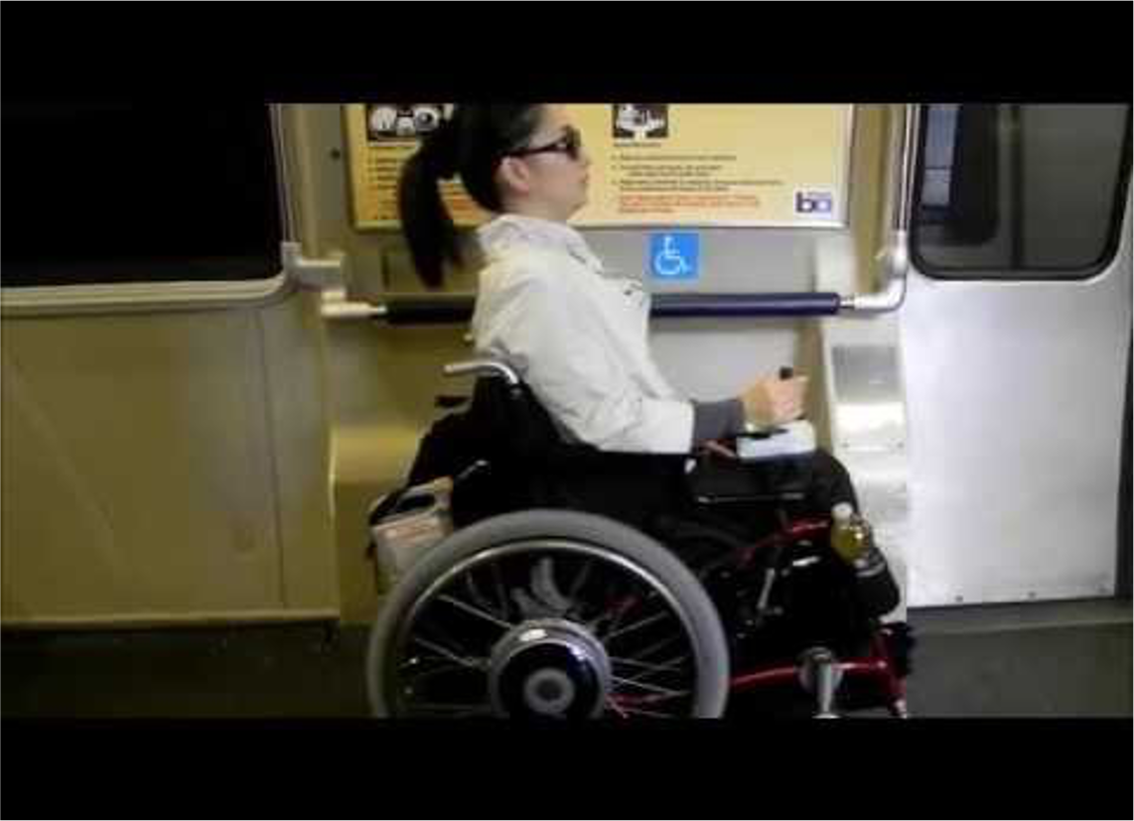
Agenda for TRACS Transportation Professionals
Welcome, Quick Introductions
Brief Review of TRACS project
Workshop Goals
Disability Awareness & Concepts
Speakers
Recommendations
Commitment to Accessibility

Slide 3
TRACS Mission and Realm
TRACS is a 2.5-year research, policy analysis and public education initiative to improve collaboration between transportation agencies and people with disabilities in the 9-county San Francisco Bay Area (Alameda, Contra Costa, Marin, Napa, San Francisco, San Mateo, Santa Clara, Solano, Sonoma)
Funded through “Sustainable Communities” focus of Caltrans SB1 Grant program.
Thank you to Caltrans for your commitment to accessibility.

Slide 4
Briefly, Achievements of TRACS
Creation and participation of our Policy Advisory Board
Completion of our research & documents
Community workshops & events over two years
Final workshops and dissemination of resources

Slide 5
Workshop Goals
Final workshop, focusing on Disability Inclusion Concepts
Send you off with perspectives and ideas for improving accessibility
Our slogan is, “Ensuring access is everyone’s job.”
Solicit commitments from you to make contact with disability organizations for a sustained relationship that will help improve accessibility in your work

Slide 6
Let’s Set the Stage
“ACCESSIBILITY MUST BE CONSIDERED AT THE FOREFRONT OF ALL POLICY DEVELOPMENT RATHER THAN TREATING IT LIKE AN AFTERTHOUGHT OR A BOX CHECKING EXERCISE. WE REALLY NEED STRONG LEADERSHIP FROM YOU.”
- SENATOR TAMMY DUCKWORTH, JANUARY 21, 2021
(CONFIRMATION HEARING OF PETE BUTTIGIEG FOR THE SECRETARY OF TRANSPORTATION)

Slide 7
Disability Awareness Basics
“Don’t ask, don’t stare” may seem polite but keeps us uninformed. If you need information, respectfully ask. If you are just curious, don’t, unless you are friends.
Staying away out of fear (you might “say something wrong!”) IS discrimination, prevents connection, adds to isolation.
People with disabilities have full lives. Their impairments aren’t the main focus or the hardest thing in life.

Slide 8
Disability Awareness Basics (cont.)
The “Medical Model” of disability locates the “problem of disability” in the individual’s body. The “Social Model” locates problems in discriminatory attitudes and policies, and barriers in the environment.
“Nothing About Us Without Us,” our slogan, challenges assumptions that “others know best.” People with disabilities are experts in access and accommodations.
People with “hidden” or “invisible” disabilities (90% of our population, e.g. arthritis, hearing impairment, cancer) are equally entitled to accommodations with wheelchair users or blind people.

Slide 9
Universal Design Concepts
Equitable Use
Flexibility in Use
Simple and Intuitive Use
Perceptible Information
Tolerance for Error
Low Physical Effort
Size and Space for Approach and Use
Our goal is to fully implement these in transportation design and operation.

Slide 10
Ensuring Access for the Future
Inclusive practice is REQUIRED by law
But how do we make community and advisory board input more impactful?

Slide 11
Speaker Presentations
Annette Williams, Accessible Services Director, SFMTA
Ernest Rogers, Chair, Solano County Paratransit Coordinating Council
Susan Rotchy, Executive Director, Independent Living Resources of Solano & Contra Costa Counties
Q&A

Slide 12
Recommendations for Transportation Agencies
Internship programs
Foster relationships with “go to” organizations in your county
Pay organizations for community input
Participate in county and regional emergency planning
Include disability and access into equity frameworks in addition to race, ethnicity, sex, etc.

Slide 13
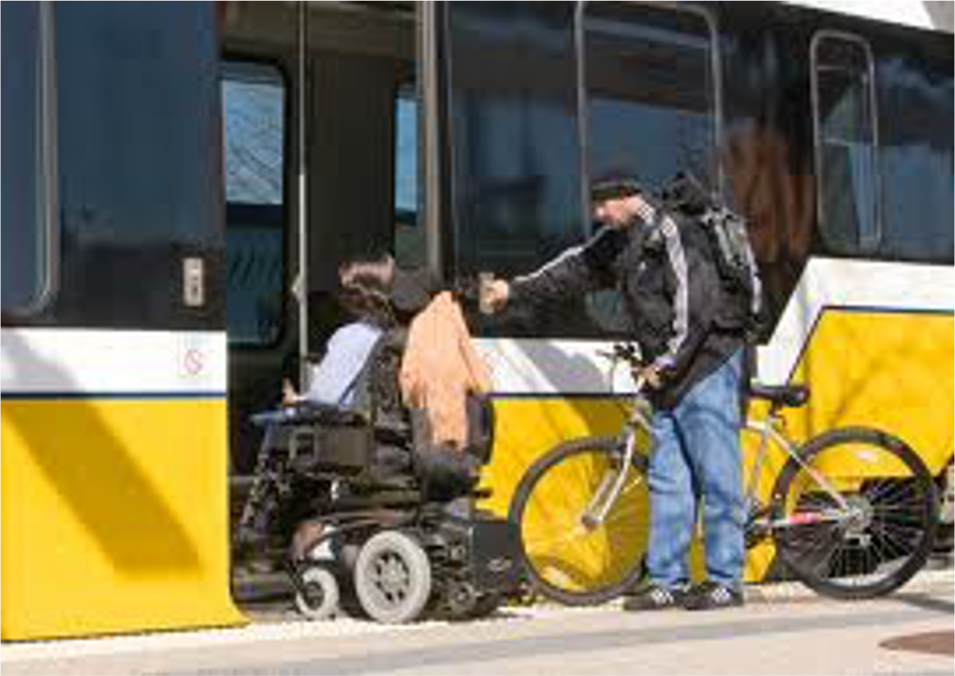
Don’t Be Afraid of Commitment
Commit today:
Establish relationships with the Disability Community
Accept that ensuring access is our job

Slide 14
Thanks for your participation and commitment!
Drennen Shelton dshelton@bayareametro.gov
Shimon Israel sisrael@bayareametro.gov
Marsha Saxton marsax@wid.org

