Slide 1
Transportation Resiliency, Accessibility and Climate Sustainability (TRACS)
Workshop for the Disability Community
WORLD INSTITUTE ON DISABILITY AND
METROPOLITAN TRANSPORTATION COMMISSION
SUPPORTED BY
CALIFORNIA DEPARTMENT OF TRANSPORTATION
ENSURING ACCESS IS EVERYONE’S JOB
Disability Community
FEB 10, 2021

Slide 2
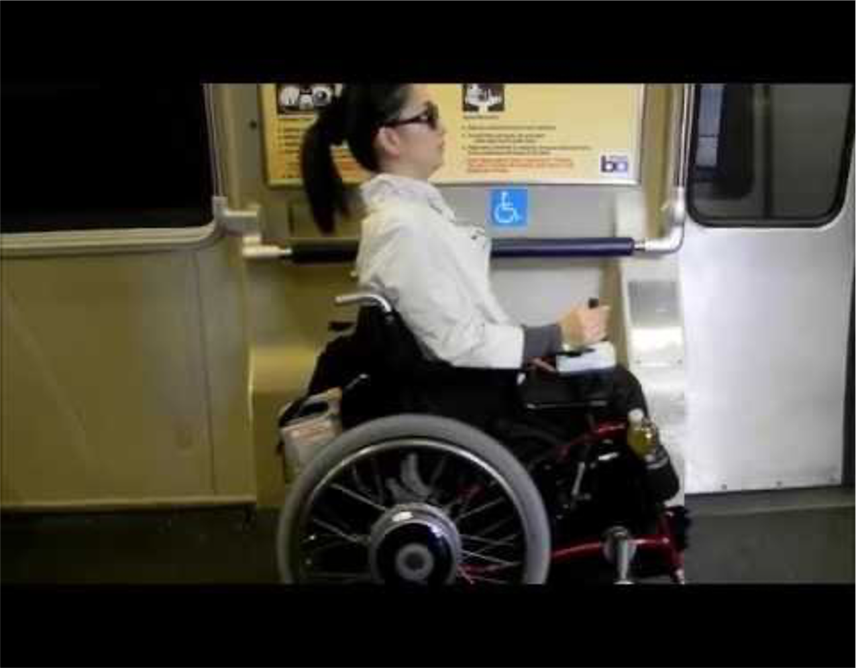
Agenda for TRACS Disability Community Workshop
Welcome, Quick Introductions
Brief Review of TRACS project
Workshop Goals
Outreach and Findings
Speakers
Transportation Advocacy
Call to Action

Slide 3
TRACS Mission and Realm
TRACS is a 2.5-year research, policy analysis and public education initiative to improve collaboration between transportation agencies and people with disabilities in the 9-county San Francisco Bay Area (Alameda, Contra Costa, Marin, Napa, San Francisco, San Mateo, Santa Clara, Solano, Sonoma)
Funded through “Sustainable Communities” focus of Caltrans SB1 Grant program
Thank you to Caltrans for your commitment to accessibility

Slide 4
Briefly, Achievements of TRACS
Creation and participation of our Policy Advisory Board
Completion of our research & documents
Community workshops & events over two years
Final workshops and dissemination of resources

Slide 5
Workshop Goals
Final workshop; Summary of Outreach and Findings
Transportation Advocacy: Our slogan is, “Ensuring access is everyone’s job.”
Sky’s-the-limit brainstorm for future transportation and a call to action

Slide 6
How We Heard From You
Policy Advisory Group
Interviews
Focus Groups
Workshops
Online Survey

Slide 7
What We Heard From You
Fixed-Route Transit
  Failing to engage disability community early or taking input
  Infrastructure issues
    Lack of signage and auditory guidance
    Construction disruption
    Broken or filthy elevators
  Driver training issues
Pass up of wheelchair users
Safety failings related to lifts, securement and not giving enough time to be seated
Unskilled in dealing with other passengers
Conflicting needs regarding accessibility (multiple issues with no clear solutions)

Slide 8
What We Heard From You (cont.)
Paratransit
  Unclear and difficult eligibility process
  Scheduling and delays
  Regional trips across jurisdictions (transfer trips)
  Curb to curb problems
  Parents with disabilities and parents of disabled children poorly served
  Huge disparities across providers (even in one county)
Private Transportation
  Lack of wheelchair accessible cabs and ride hail services
  Expensive

Slide 9
Accessible Ride Hail on the Horizon
TNC Access for All Act
$.10 per completed ride creating Access Fund
Ride hail companies are starting to provide service
Access Fund is in each County
Potential for additional providers in 2022
Follow the rulemaking at the CPUC: https://www.cpuc.ca.gov/tncaccess/

Slide 10
Speaker Presentations
Annette Williams, Accessible Services Director, SFMTA
Ernest Rogers, Chair, Solano County Paratransit Coordinating Council
Q&A

Slide 11
Transportation Advocacy
Disability rights community has a proud history of transportation activism
Enforcement of policy is often through the public’s
interaction with decision makers
Public comment, formal complaints, media
Use personal stories
Make friends with transportation agency staff
Contact elected officials directly

Slide 12
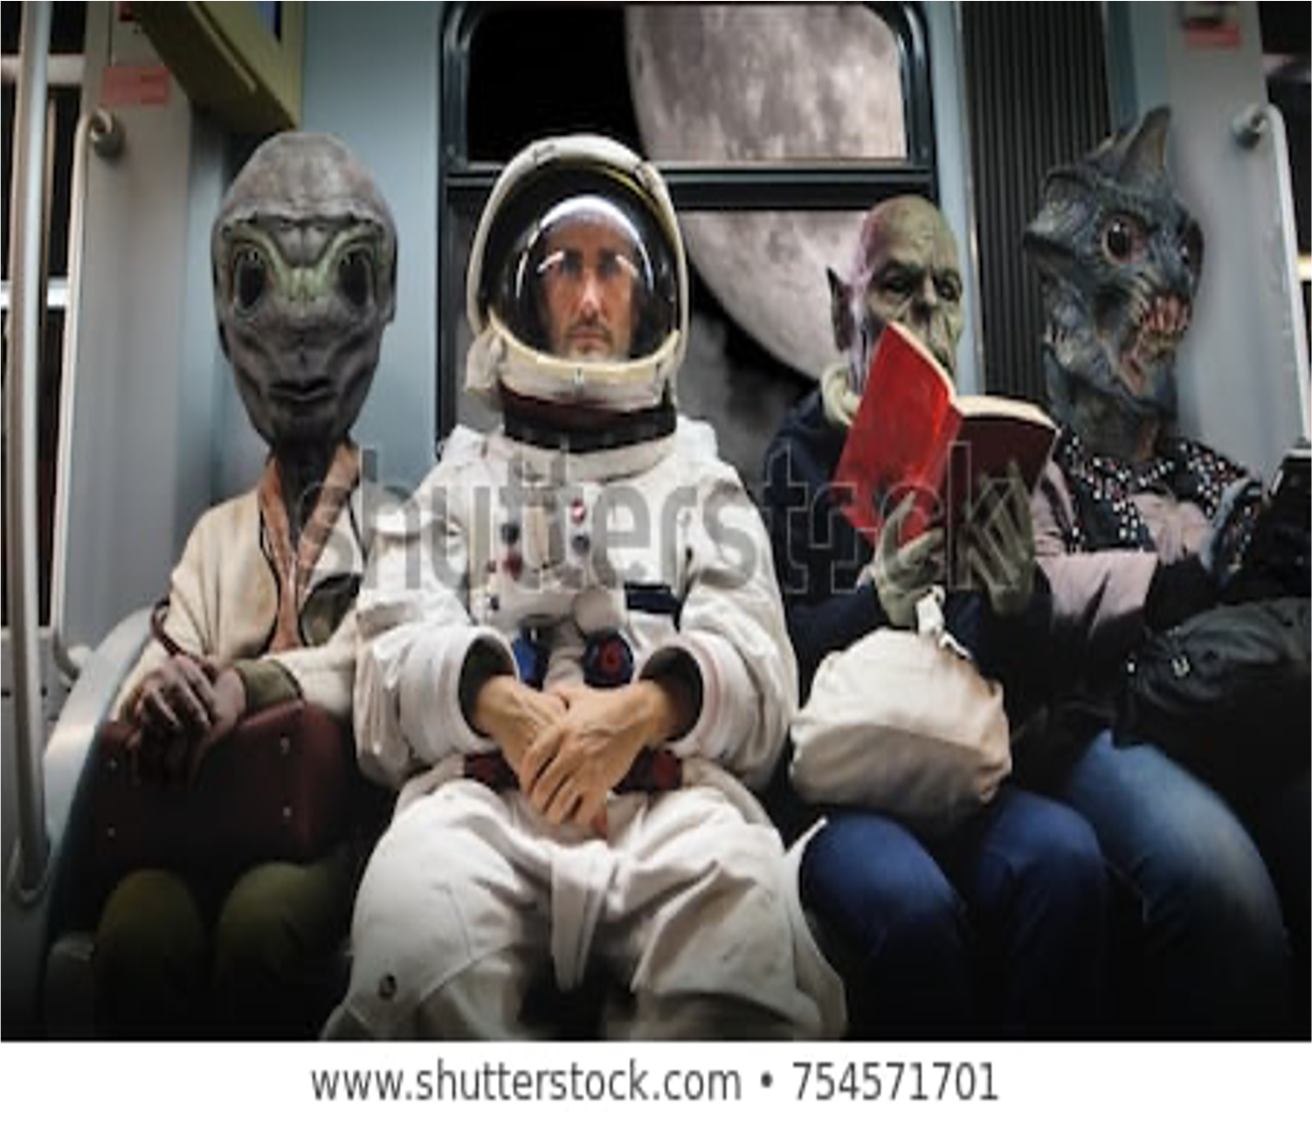
Hopes and Dreams for the Future
Sky’s-the-limit brainstorm exercise

Slide 13

Call to Action
TRACS is ending, but the conversation should continue
Challenge: Deliver a public comment at a transportation agency or
MTC meeting in the next month

Slide 14
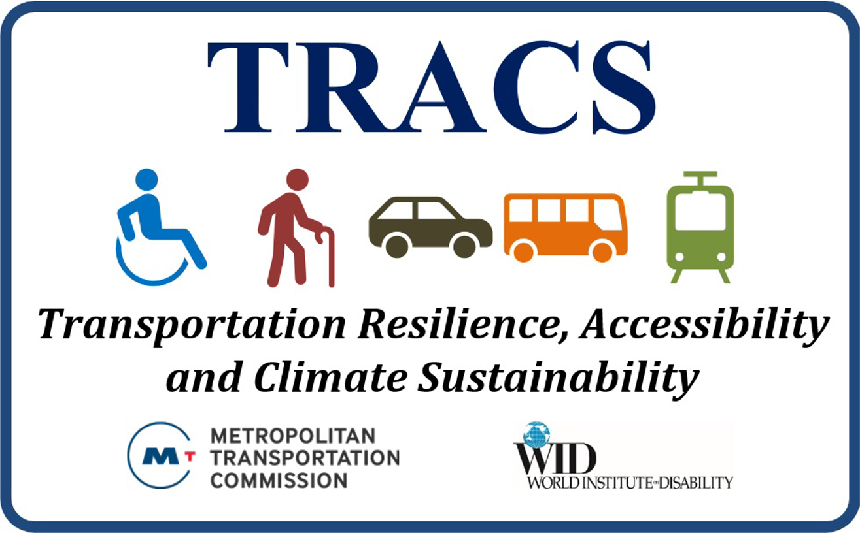
Thanks for your participation and continued advocacy!
Drennen Shelton dshelton@bayareametro.gov
Shimon Israel sisrael@bayareametro.gov
Marsha Saxton marsax@wid.org

