Slide 1
Transportation Access Matters! Past, Present, Future TRACS Keynote Address, October 7, 2019
Annette Williams
Manager, SFMTA Accessible Services
Notes:
(You’re going to be introduced, so no need to re-intro)

Slide 2
Big Ideas
History
Geometry
Intersections
The Future
Notes:
Today, I’d like talk with you about four big ideas:
History, Geometry, Intersections, and the Future.
In the context of accessibility, they are vital to understanding the legacy of disability rights, the present state of access, and how we need to consciously build our future.

Slide 3
History
Notes:
The history is clear, activists with disabilities and people organizing for their rights are the reason accessibility is on the agenda today.

Slide 4
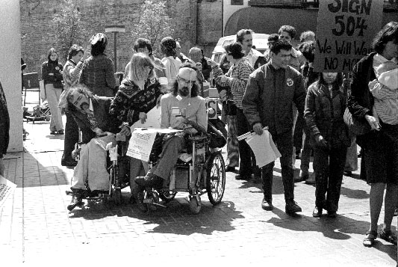
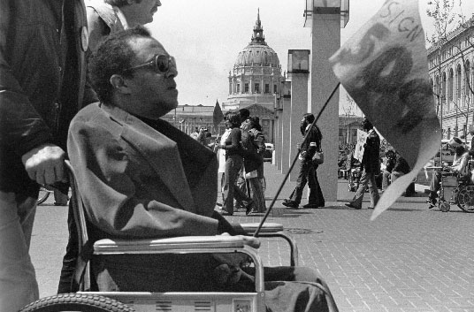
Disability Rights Movement
Bay Area birthplace of Disability Rights Movement
1973
Rehabilitation Act
Section 504
Any entity receiving federal funding cannot discriminate based on disability
1977
Section 504 not taken effect
Demonstrations across the US
Notes:
The Bay Area is known as the birthplace of the Disability Rights Movement, and the community we serve, rightly, has high expectations for our services.
In 1973, Congress passed the Rehabilitation Act.
Section 504, which is only a sentence or two long
Mandated that any entity that receives Federal funding may not discriminate against people with disabilities.
1977, 4 years later, the Rehabilitation Act still had not taken effect,
Rules and regulations needed to implement this legilslation hadn’t been written.
By April 1977, people with disabilities around the country organized demonstrations.
Largest demonstration was organized by leaders at the Berkeley Center for Independent Living.
Demonstrations took place in San Francisco's Federal building, 50 United Nations Plaza, at the offices of Health, Education and Welfare (HEW).

Slide 5
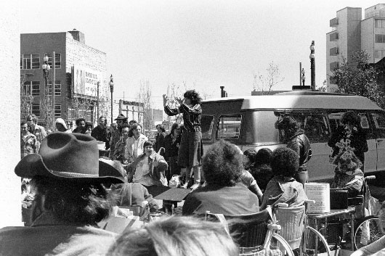
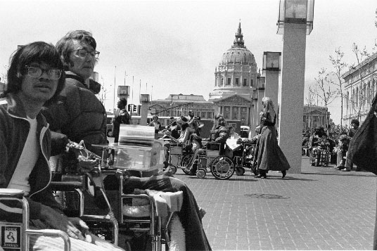
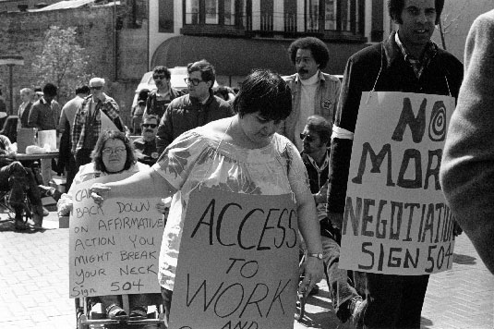
San Francisco Federal Building Sit-In, 1977
Notes:
The occupation of the Federal Building in San Francisco sit-in lasted for 28 days.
Over 100 people sat in at that demonstration
This sit in I understand, still holds the record for the longest sit-in of any federal building in U.S. history.
For the first time, a broad range of disability groups had joined together in coalition, as would also be the case with the ADA.

Slide 6
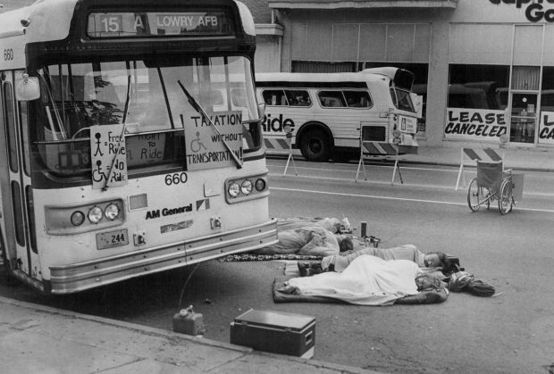
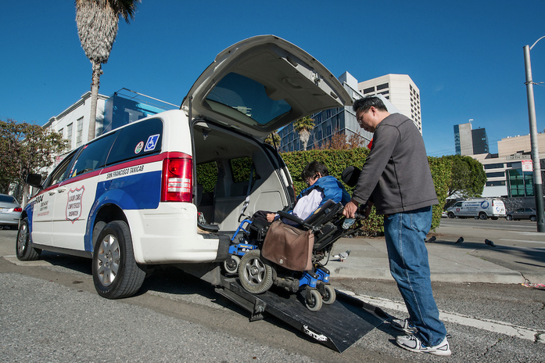
Disability Rights Movement (cont’d)
1980
First accessible Muni buses
Beginning of SF Paratransit
1980’s
Demonstrations at APTA meetings
1990
Americans with Disabilities Act (ADA)
1992
Designated network of accessible rail stations/stops to meet ADA Key Station requirements
1994
First ramped taxis in San Francisco
Notes:
Subsequent to that protest, public transit agencies were required to provide accessibility, whether through fixed-route or paratransit.
Called “local option”, Muni began implementing access, all purchases of new buses being accessible and began a Paratransit van program in late 70’s with use of taxi in Paratransit coming soon after in 1983.
Paratransit to meet the needs of disabled people who couldn’t take fixed route.
Even with “local option” movement to implement transit accessibility was slow around the county, only Cal and Michigan had state requirements that all new buses must be lift equipped.
Demonstrations continued at the American Public Transit Association (APTA) meetings for much of the 1980’s, including in Denver, CO and here in SF in 1987. Locally we worked closely with the disability community prior to the conference to try to show that progress was being made in the Bay Area but was clear that locally and even more nationally progress was slow
1990 the ADA was passed and signed by President Bush it required Equal Access be provided to all public accommodations including transportation.
ADA required both fixed route access and paratransit and key station access to legacy rail systems. Muni continued to replace all the fleet with accessible buses and to build accessible key stops on the Muni Metro system
1994: first accessible ramped taxis were put into service in San Francisco. Prior to that most ambulatory customers were using taxi and wheelchair users lift vans but both programs were expanded to better meet needs. Outer area and rainy days were hard for taxi and van worked better for some ambulatory customers and w/c users wanted same day taxi service options too.

Slide 7
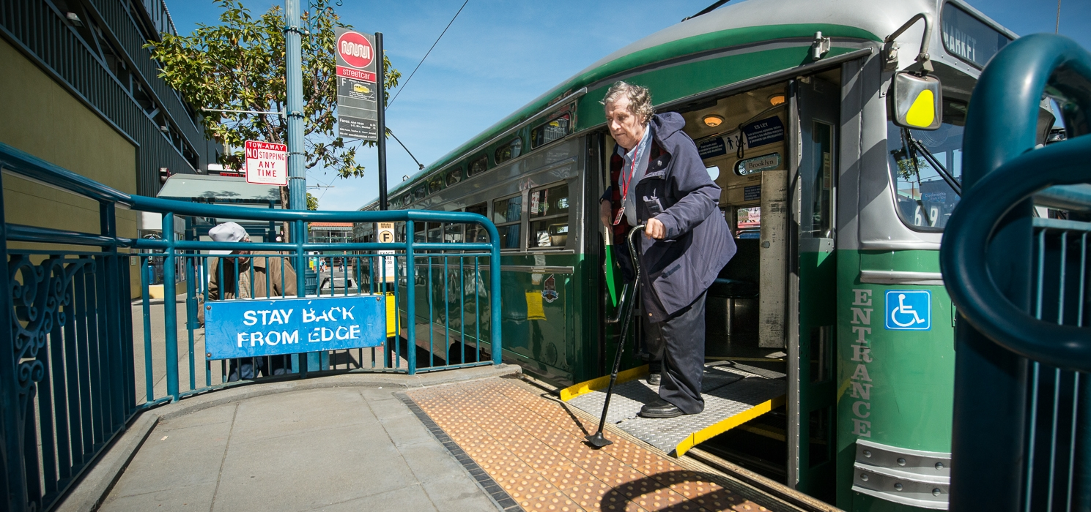
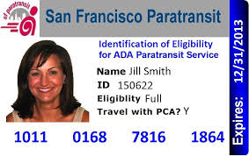
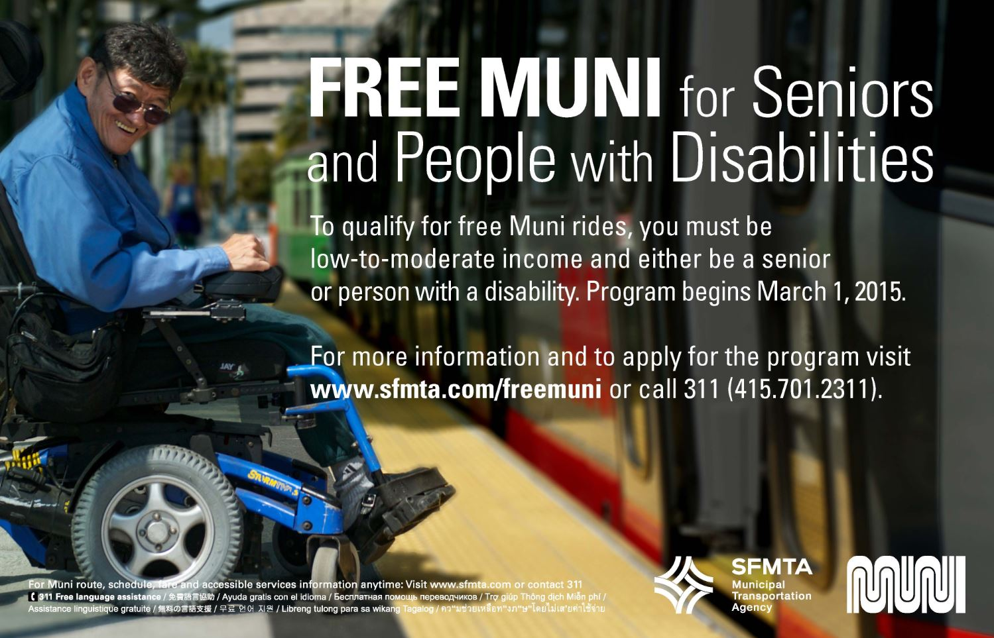

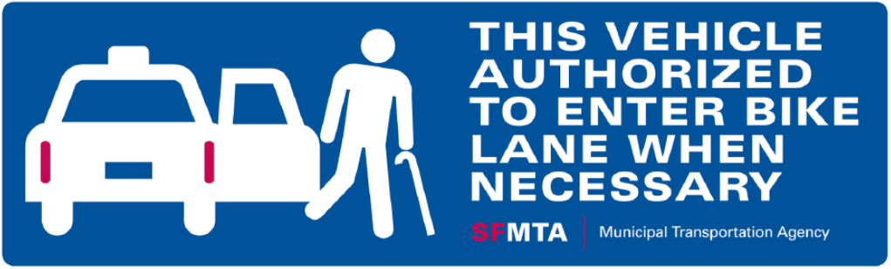
Other Improvements by SFMTA
Notes:
Since then, SFMTA has provided other services to better serve seniors and people with disabilities.
This history lesson is to show how important disabled access is to our community here locally and to be clear that disabled people have fought long and hard for equal access and have high expectations for our services.
Example: wheelchair user who watched his whole childhood as the PCC cars passed by in his neighborhood and then finally as a 40-year-old being able to use those cars on the Historic F -line.

Slide 8
Geometry
Notes:
Next is Geometry.

Slide 9
Geometry: Making Civil Rights Real
Make civil rights real in physical space
Accessibility is everyone’s responsibility
Build in accessibility from Day 1
People with disabilities are a valuable consumer base
“Nothing for us without us”
Engage consumers and use their feedback
Beyond compliance, meet the needs of users
Notes:
It all often comes down to space, and geometry is often how you make civil rights real in the physical space.
Accessibility is everyone’s responsibility
We need planners, engineers, policy analysts, everyone
Building in accessibility from the ground up is always cheaper than having to retrofit
People with disabilities are an important part of our consumer base, and we need to hear from them to make sure what we’re doing serves them
People with disabilities and seniors know best what they need
“Nothing for us without us,” Disability Rights rallying cry, and working with users and getting their feedback is only way to truly serve the community
Go beyond compliance: will this actually meet the needs of users?
Example: ADA may mandates 30” x 48” for a wheelchair stationing area on-board a bus, but if there is no room for someone to maneuver their chair, effectively useless
For able bodied staff and users, they may not see the need or problem because they have not experienced it, so need to return to the users and test and try things
We need to press within our organizations for the feet and the inches that best meet needs because we live with the choices we make for years to come. This is an opportunity to serve the public at every stage
Colleague engineer who pushed back some when we were designing platforms in Fisherman’s wharf because they were hard to fit in and merchants were not enthusiastic and then later he had a mother in law in wheelchair and his own fight with cancer and he appreciated so much the efforts he had made to make sure that f-line extension was fully accessible.
We would never buy a bus without seats, so why would we buy one without lifts, securement areas, digital voice announcements, etc.

Slide 10
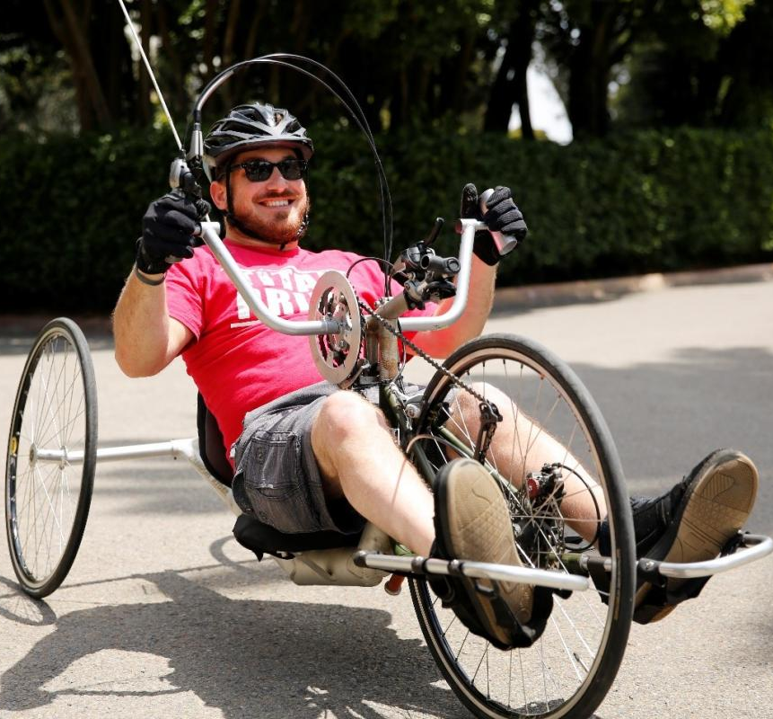
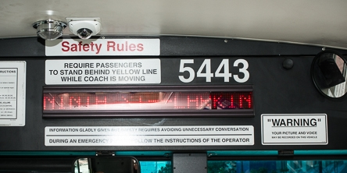
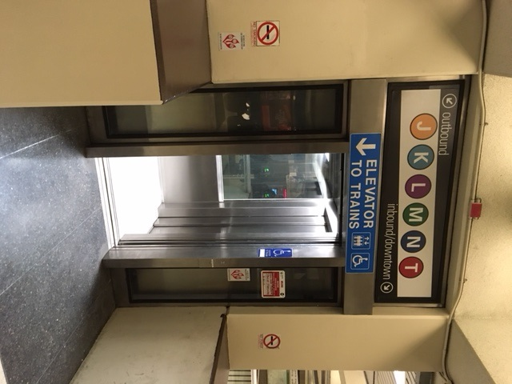
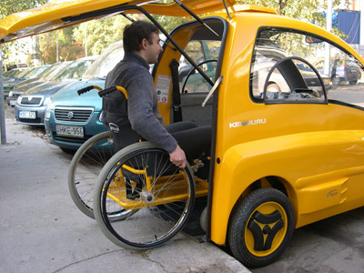
Geometry: Interventions
You also need interventions
beyond feet and inches.
Notes:
Not all accessibility challenges are solved by inches and feet some take other interventions:
Examples include automated stop announcements, new elevators, the design of autonomous vehicles including grab bars, adaptive bike share, etc.
Some interventions need to be social: that we change the attitudes towards people with disabilities and seniors as part of serving the public; people are not the problem, the lack of access is the problem
But making sure to claim the inches necessary for true access is important.

Slide 11
Intersections
Notes:
The third idea is Intersections.
This often means continental crosswalks, curbs, daylighting, countdown signals, turning radii, inclusion of APS and a whole host of best practices.
But it also means how we connect with each other and how making services work better for people with disabilities improves them for many others as well.

Slide 12
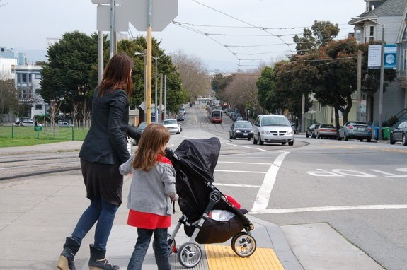
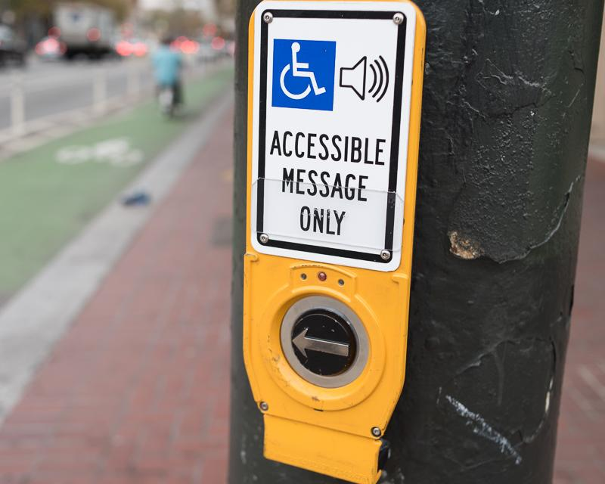
The Curb Cut Effect
Technology designed for people with disabilities can help everyone.
When assistive technology is installed often enough, it becomes the norm.
Notes:
Ax example is the curb cut effect.
Where an intervention meant to serve one group benefits everyone, potentially in unexpected ways – parents with strollers, food carts, easier to find crosswalk etc. Now it’s the norm and the expectation of all users.
Another example is Audible pedestrian signals (APS),
I find I use the audio cues myself as a cue to cross the street, especially when distracted, reading something, etc.
https://www.sfmta.com/sites/default/files/styles/teaser-col-4/public/feature-image/2017/171108_rsd_cswk_34.jpg?itok=p20UkLon

Slide 13
Universal Design
“The design of products and environments to be usable by all people,
to the greatest extent possible,
without the need for adaptation or specialized design”
– Ron Mace, Founder of Universal Design Center at UNC
Notes:
This is also an example of Universal Design, defined as “the design of products and environments to be usable by all people, to the greatest extent possible, without the need for adaptation or specialized design” according to Ron Mace, the coiner of the term.

Slide 14
7 Principles of Universal Design
Equitable Use
Flexibility in Use
Simple and Intuitive Use
Perceptible Information
Tolerance for Error
Low Physical Effort
Size and Space for Approach and Use
(Center for Universal Design, 2000)
Notes:
Universal Design has 7 Principles
Equitable use—
the design is useful and marketable to people with diverse abilities.
Flexibility in use—
the design accommodates a wide range of individual preferences and abilities.
Simple and intuitive use—
use of the design is easy to understand, regardless of the user’s experience, knowledge, language skills, or concentration level.
Perceptible information—
the design communicates necessary information effectively to the user, regardless of ambient conditions or of the user’s sensory abilities.
Tolerance of error—
the design reduces hazards and adverse consequences of accidental or unintended actions.
Low physical effort—
the design can be used efficiently and comfortably and with minimal fatigue.
Size and space for approach and use—
appropriate size and space are provided for approach, reach, manipulation, and use regardless of user’s size, posture, or mobility

Slide 15
People with Disabilities are Vulnerable in Multiple Ways
People with disabilities in San Francisco…
Are more likely to not be working/unemployed
Almost 50% earn less than $25,000/year
35% take public transit
Similar to the able-bodied population
Over 1/5 of people who identified as Black/African-American identified as having a disability
Twice the rate of other racial groups, includes all ages
(Source: Table S1810 “Disability Characteristics,” 2013-2017 ACS 5-year Estimates)
Notes:
Intersections are not just technical, but social—that is people with disabilities and seniors are at the intersection of many vulnerabilities:
In San Francisco, people with disabilities:
Are more likely to not be working
Almost ½ earn less than $25,000/yr
35% are taking public transportation (similar to able-bodied population)
And over 1/5 of people who identified as Black or African-American also identified as having a disability
(almost twice as many as in other racial groups, includes all age groups)

Slide 16
Seniors are Vulnerable in Multiple Ways
Seniors in San Francisco…
37% identify as having a disability
Almost a third of 65+ year olds are 80+
55% speak a language other than English
40% of them speak English “less than very well”
Over 80% of seniors not in the labor force
Almost half of seniors are renters
54% of renting seniors are rent-burdened*
*Spending 30% or more of income on rent
(Source: Table S0101 “Age and Sex,” 2013-2017 ACS 5-Year Estimates; Table S0103 “Population 65 Years and Over in the US,” 2013-2017 ACS 5-year Estimates)
Notes:
Seniors in San Francisco are also vulnerable:
37% identify as having a disability
Almost a third of people over 65 are 80 or older
55% of seniors speak a language other than English and of those, about 40% speak English “less than very well”
Over 80% of seniors not in the labor force,
And of seniors renting, more than half of seniors renting are rent-burdened (pay more than 30% of income to housing

Slide 17
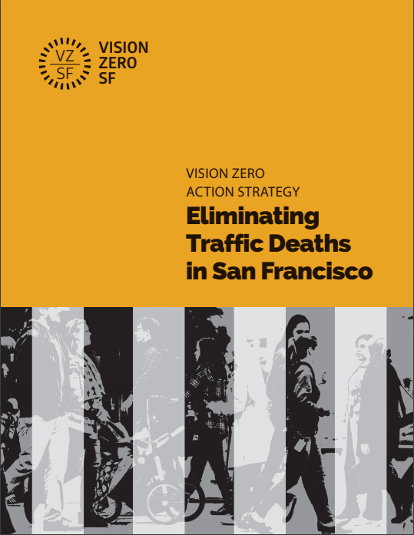
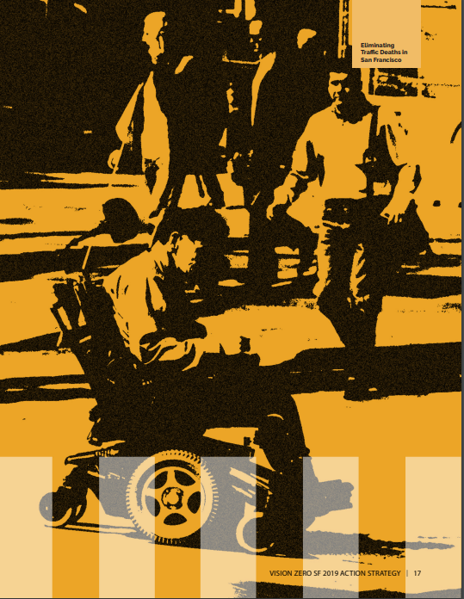
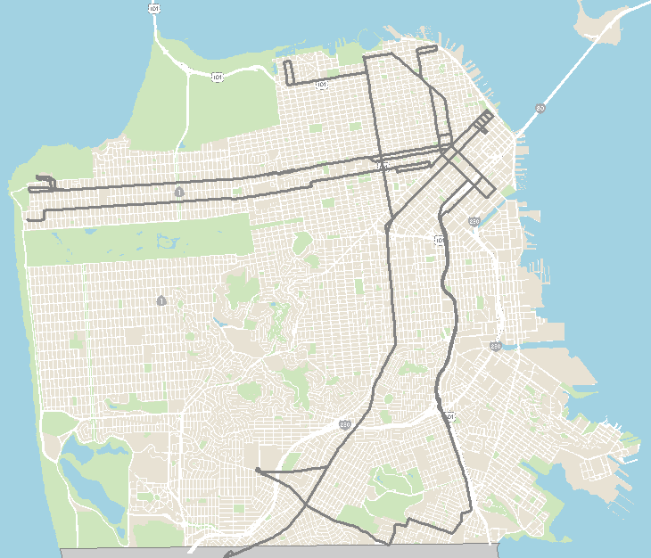
Centering Vulnerable Populations
Vision Zero
Equity Lines
Seniors account for ~50% of pedestrian deaths, but comprise only 15% of the SF population
Crowding → More frequent headways
Notes:
Centering the most vulnerable people improves conditions for everyone in a way that does not occur when prioritizing people with more privilege
Example: Vision Zero, seniors account for ~50% of pedestrian deaths, but only 15% of the SF population
Making it easier and safer for seniors to use our streets means e prioritizing street investments that all pedestrians benefit from
longer crossing times, clearer crosswalks, pedestrian refuge islands, shorter crossing distances, etc.
Acknowledge that this can cause other conflicts, ex. On-time performance for transit
Example: Equity lines most used by seniors and people with disabilities
A significant issue for these communities is crowding
No room to board, no seats, pass ups, no room for mobility aids
More frequent headways can solve this problem
Improving service for everyone because people with disabilities and seniors rely on the same core service
Even more important because lacking other options
Some of the highest need areas in the city, also meeting low-income, people of color, limited English speakers, etc.

Slide 18
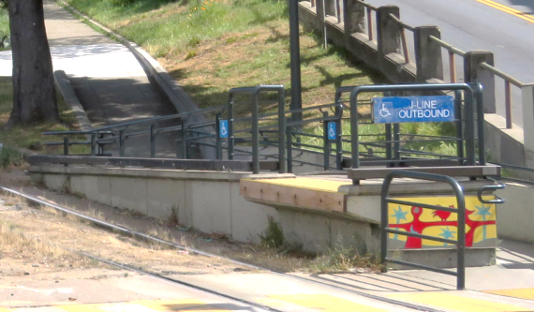
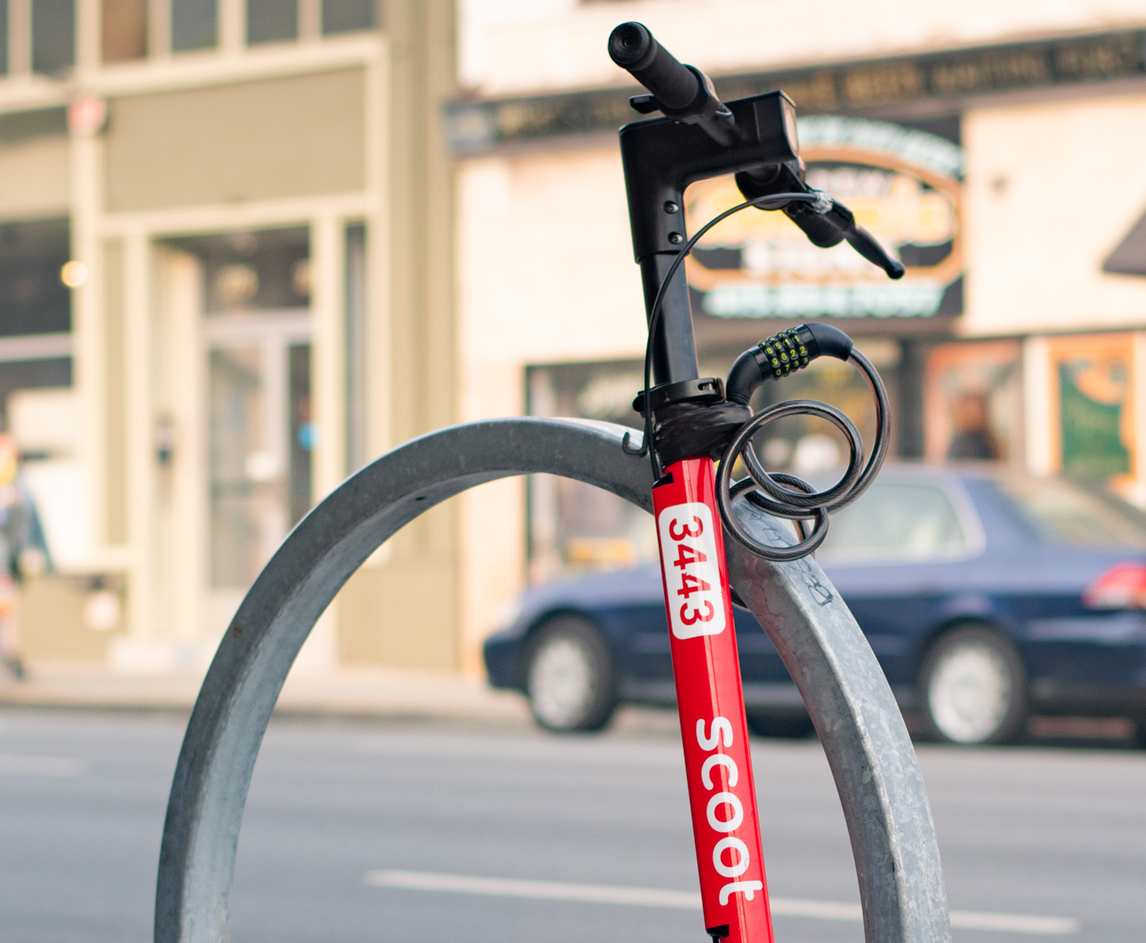
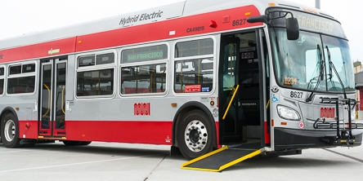
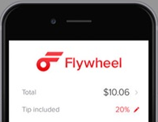
Other Accessible Interventions
When we make things better for people with disabilities, we can meet a multitude of needs.
Notes:
When we make things better for people with disabilities, we are meeting a multitude of needs.
Mini-high Platform, low-floor buses, lock-to for scooters, Flywheel app

Slide 19
The Future
Notes:
And finally, the Future.
The only thing we know for sure is coming is change.

Slide 20
Fewer people driving is good for the future
Less VMT
Alternatives and choices
Historically limited for seniors and people with disabilities
Transportation is key for these communities
Latent demand
Notes:
Less VMT
Better fixed route service means less specialized service, more people able to choose sustainable modes
Need to make alternatives to driving viable for the most people and to increase the number of choices for people
Access to transportation choices has historically been incredibly limited for people with disabilities and seniors, and public transportation is KEY to independence and full community participation for people with disabilities.
There can be latent demand for our services! People with disabilities may not have seen that the fixed route system was available to them and better fixed route services can improve lives.

Slide 21
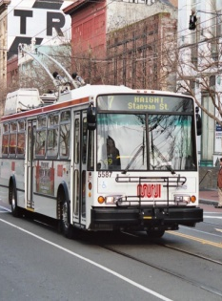
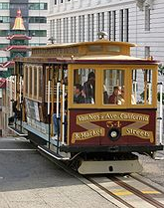
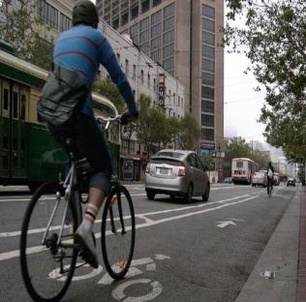
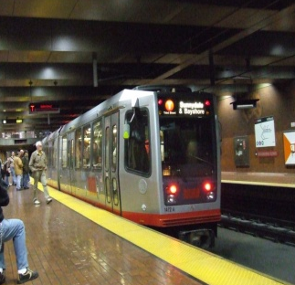
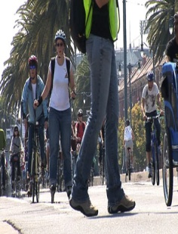
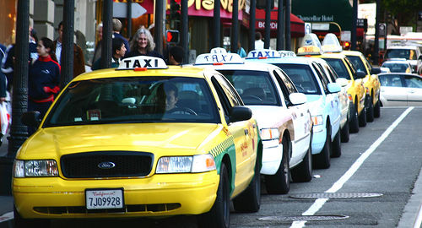
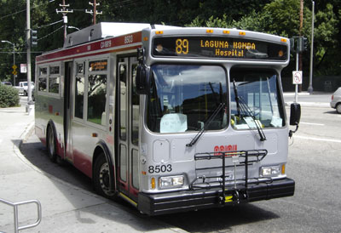
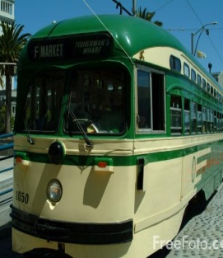
Demographics are Changing
Seniors are fastest growing demographic
Living longer
Aging in place
Tech savvy seniors
Public all want convenience
Notes:
Alongside our climate, demographics are changing too:
Seniors are the fastest growing demographic
More people are living longer
Want people to age in place
Tech savvy seniors
Higher expectations for mobility management, trip planning
People with disabilities and seniors want what the general public wants: be able to make transportation choices, have them be seamlessly accessible, and that when there is a barrier, it is because of a breakdown in the system, not that the system itself functions to exclude

Slide 22
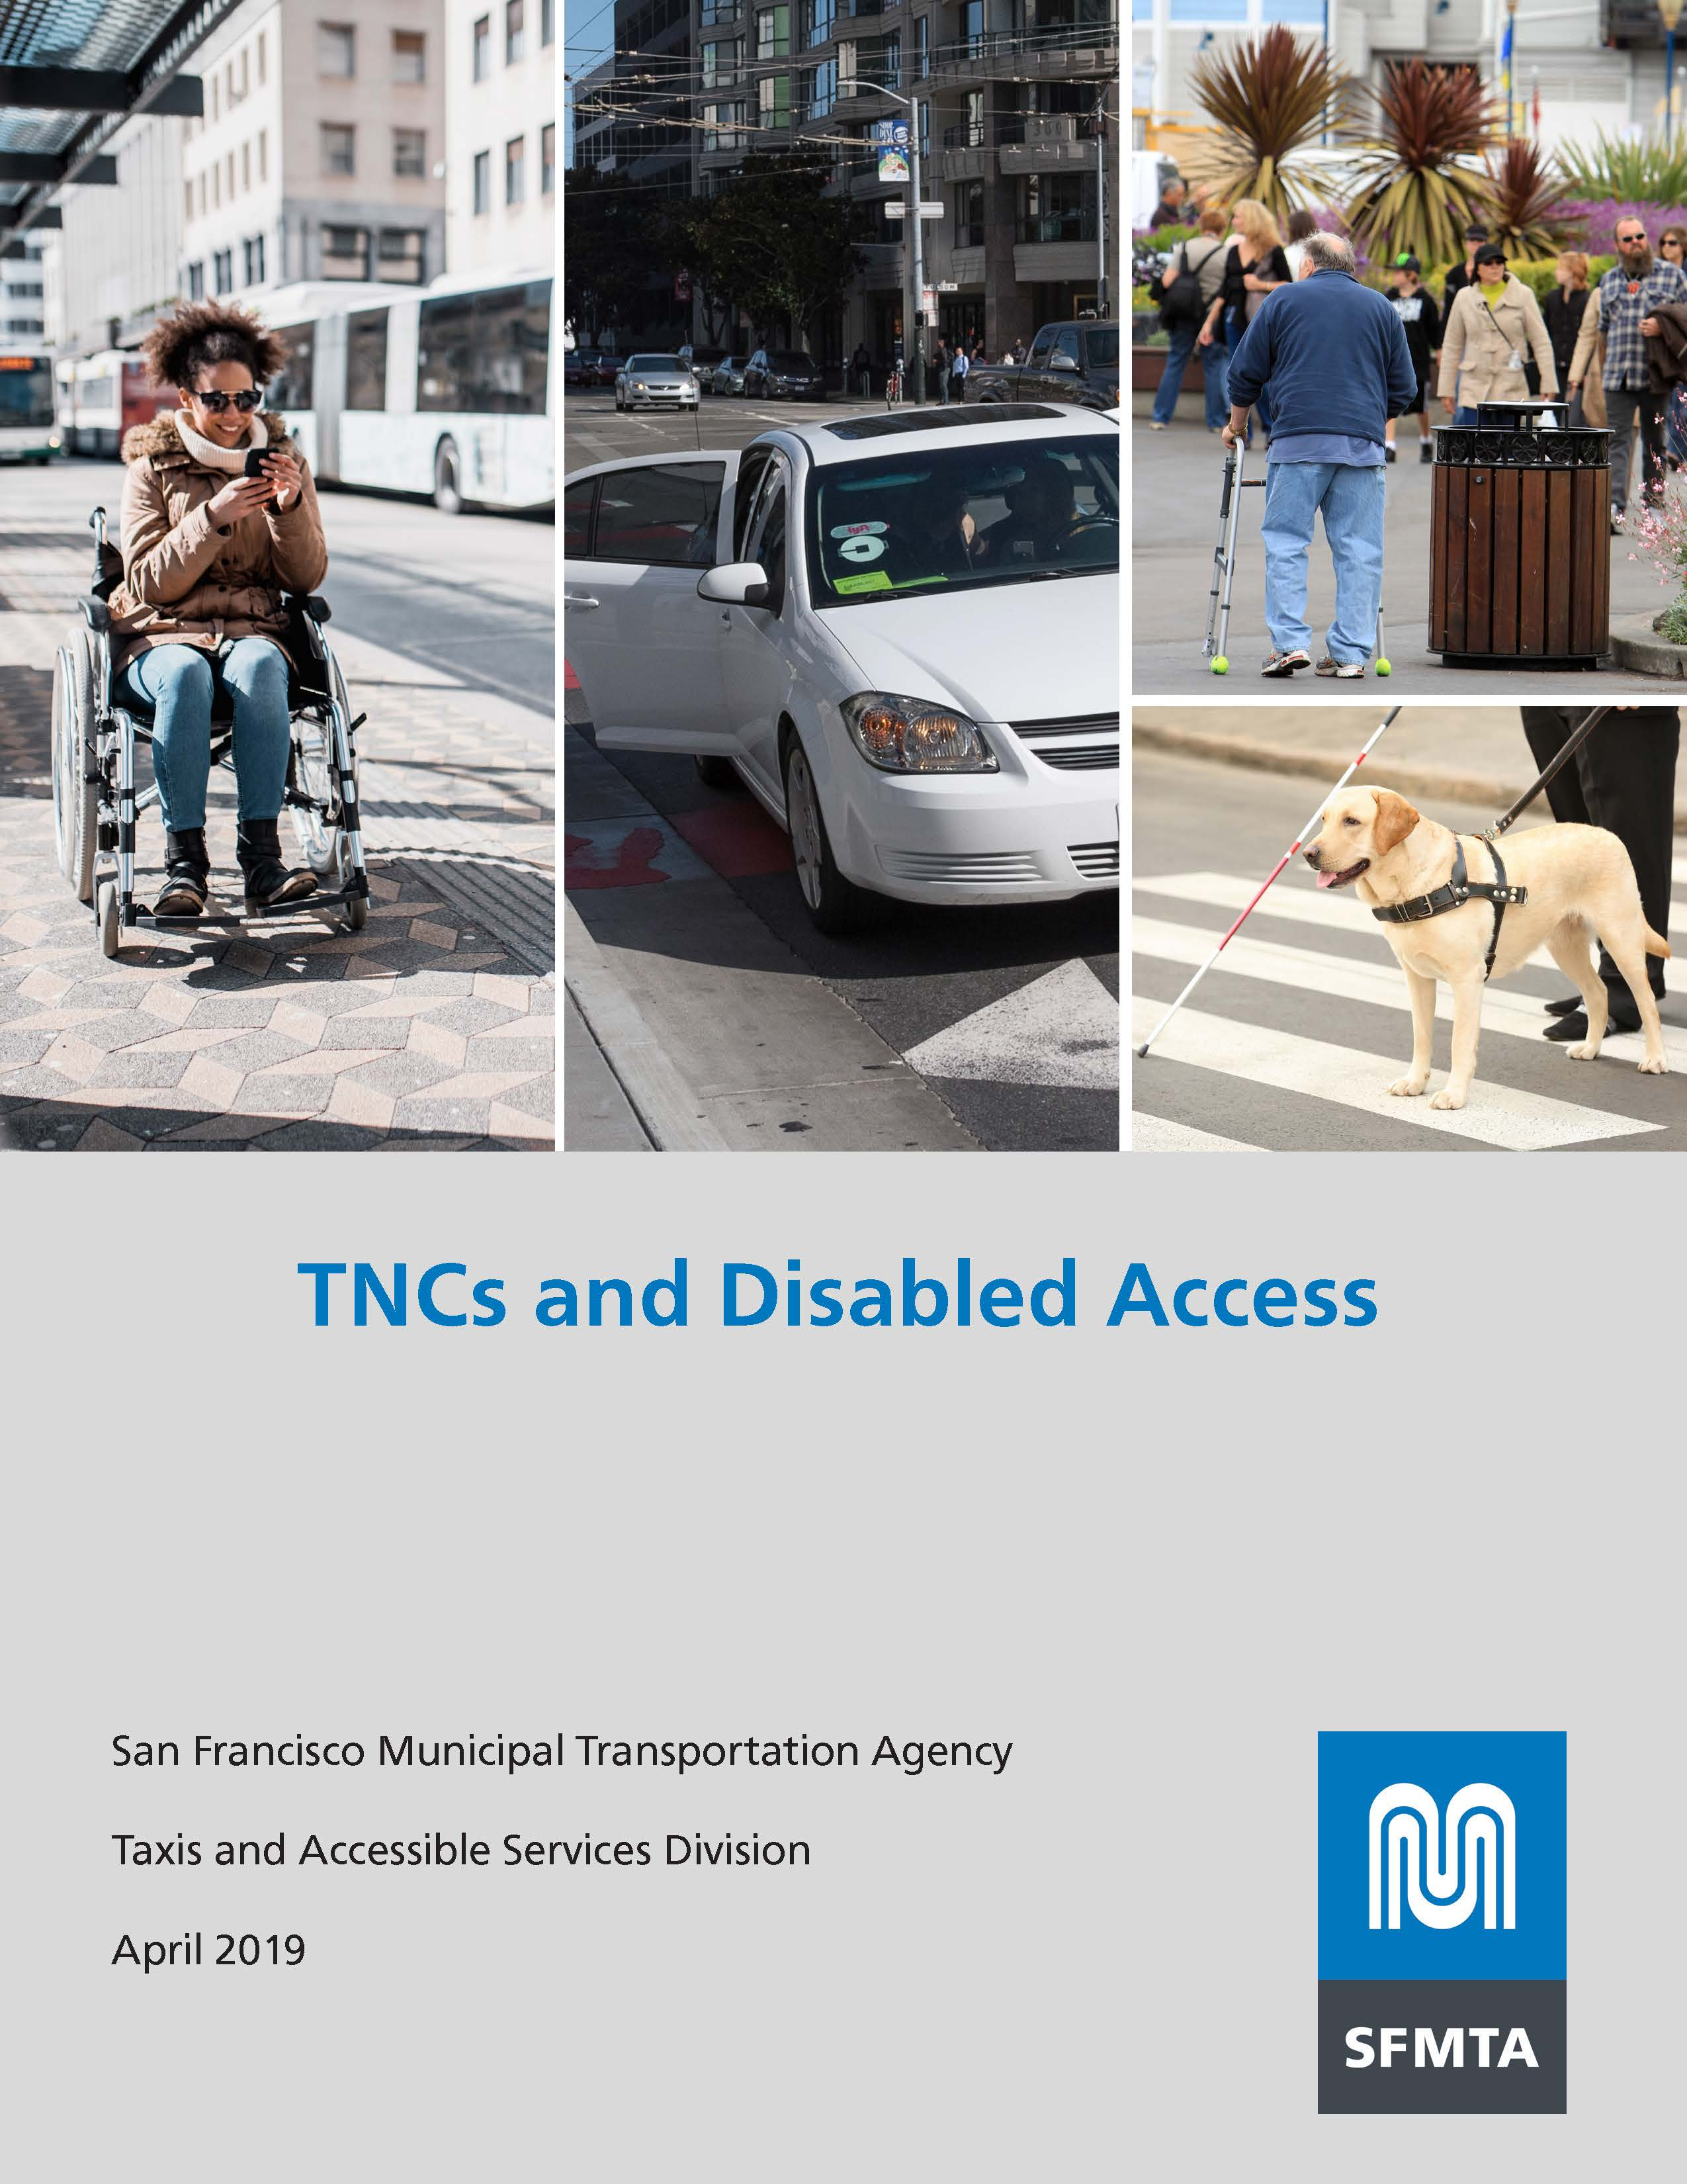
Transportation is Changing
Emerging mobility
TNCs Disabled Access
New technology
Avs
Users and nonusers
Be proactive, not reactive
Notes:
Transportation is changing:
Emerging mobility
TNCs and Disabled access
How can emerging mobility increase options for everyone, not just the few
Been a game-changer for people with visual or hearing impairments, hiring drivers with hearing impairments
Been until recently non-existent for people who use wheelchairs and other mobility aids who need accessible vehicles
New technology: Autonomous Vehicles
Will they be “born accessible”?
Make sure new modes do not negatively impact nonusers and their right to public space
Lock-to in SF, keeping clear the path of travel
Must be proactive, not reactive

Slide 23
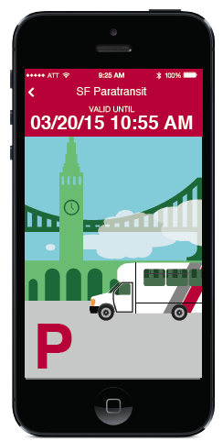
Funding
Be smart with current funding
New funding sources
FASTER Bay Area
Paratransit
Cost
Technology
Affordability
Notes:
Funding
Cost-effective use of current funding
As there are new sources of funding, we should pursue them for innovative projects
When contemplating new funding sources like the upcoming FASTER Bay Area, should include accessibility needs such as greater frequency on lines serving seniors and persons with disabilities projects, and more funding for paratransit as needs and demographic changes demand it.
How do we communicate with tech savvy seniors?
Paratransit one of the things that is just expensive
Cost of paratransit expected to rise
More users
Labor
Rising rent for facilities
Fuel, etc.
How we deliver paratransit services and the type of service provided in the future will be heavily influenced by emerging mobility technology
How do cities incorporate some of the functionalities that are found in the emerging mobility technology to improve service
(I.e. vehicle tracking, scheduling trips, on line scheduling, app-based reservations systems)
Affordability of services is, and will continue to play, a major factor in how usable they are for people with disaiblities

Slide 24

Climate is Changing
“New normal”
Extreme weather, rising temperatures, rain, etc.
Vulnerable people
Build Resiliency into our transportation system
Better service now
Emergencies
Notes:
Finally, as the climate changes, our “new normal” is changing
“New normal”
Extreme weather, rising temperatures, increased rain, etc.,
Puts vulnerable people at greater risk; both on a daily basis and during emergencies
We need to build resiliency into our transportation system
This means serving vulnerable people better during normal conditions, so that when an emergency occurs, there are options
When something doesn’t work, when the power is shut off, when the rail line is flooded, when the buses are rerouted to emergency services, there are limited back-up choices
More choices on a daily basis means greater choice and access when systems go down

Slide 25
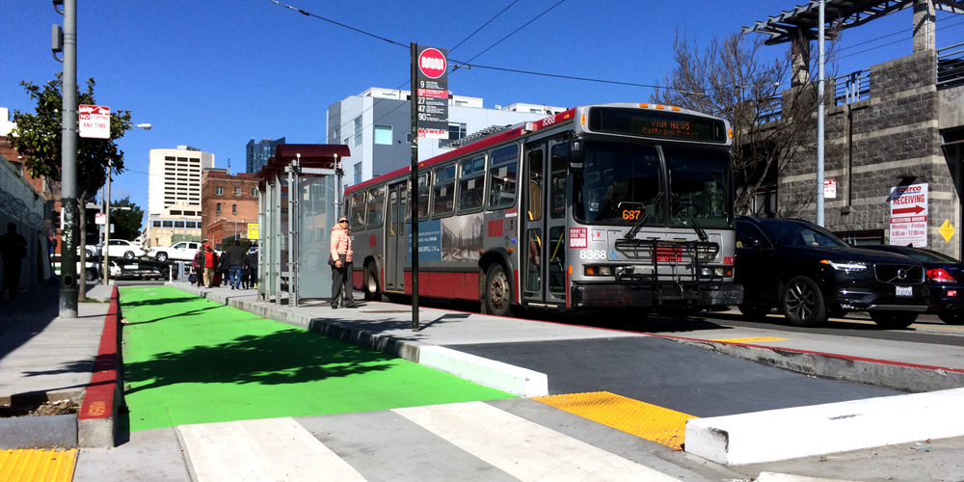
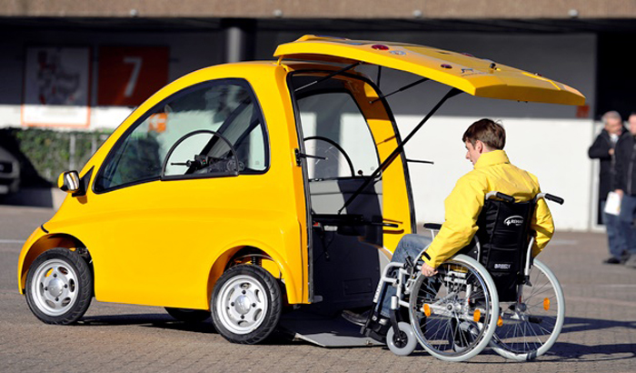
Wrap Up - Big Ideas
History
Geometry
Intersections
The Future
Notes:
History –
activism is why we have accessibility
what does it mean to meet needs not just compliance with laws
“nothing for us without us”
What kind of activism is going to be necessary moving forward how do we prioritize public transit, and to make sure needs to seniors and persons with disabilities are at the forefront.
Geometry –
Key to making civil rights real
costs money, but is always cheaper to include accessibility from the beginning of a project
permeate responsibility throughout your agencies
make sure your colleagues think about accessibility too,
Educate them and encourage interaction with users
need everyone talking to their users
(direct audience: under your chairs, a resource about accessible meetings, also come up and talk to us after, accessible meeting toolkit)
Intersections –
look for Universal Design solutions
Because of who people with disabilities and seniors are, centering them means serving multiple communities
when you improve things for the most vulnerable communities, you improve conditions overall
Future –
change is coming, and change is happening:
Climate
Demographics
emerging mobility
we need to be cost-effective
build in resiliency now
Go beyond the regulations, what is actually needed to meet the needs of our communities and realize our fully accessible dreams.

Slide 26
Contact Information
Annette Williams
San Francisco Municipal Transportation Agency
Manager, Accessible Services
Annette.Williams@sfmta.com
Notes:
Thank you!
Thanks to all the Accessibility staff at SFMTA and SF Paratransit for their hard work everyday.
And especially to Abby Brown our amazing intern who helped with this presentation.

