Slide 1
Webinar: GADRA Activates to Türkiye and Syria
Thursday, March 9th at 10 AM EST (NY)/ 6 PM TRT (Türkiye & Syria)

Slide 2
Judy Heumann
Disability Rights Icon and Co-Founder of the World Institute on Disability
1947 – 2023

Slide 3
Colombian National Organization of the Blind, Colombian National Coordinator of Persons with Limited Vision, and the Colombian National Council of Persons with Disabilities
Hurricane Iota in Colombia

Slide 4
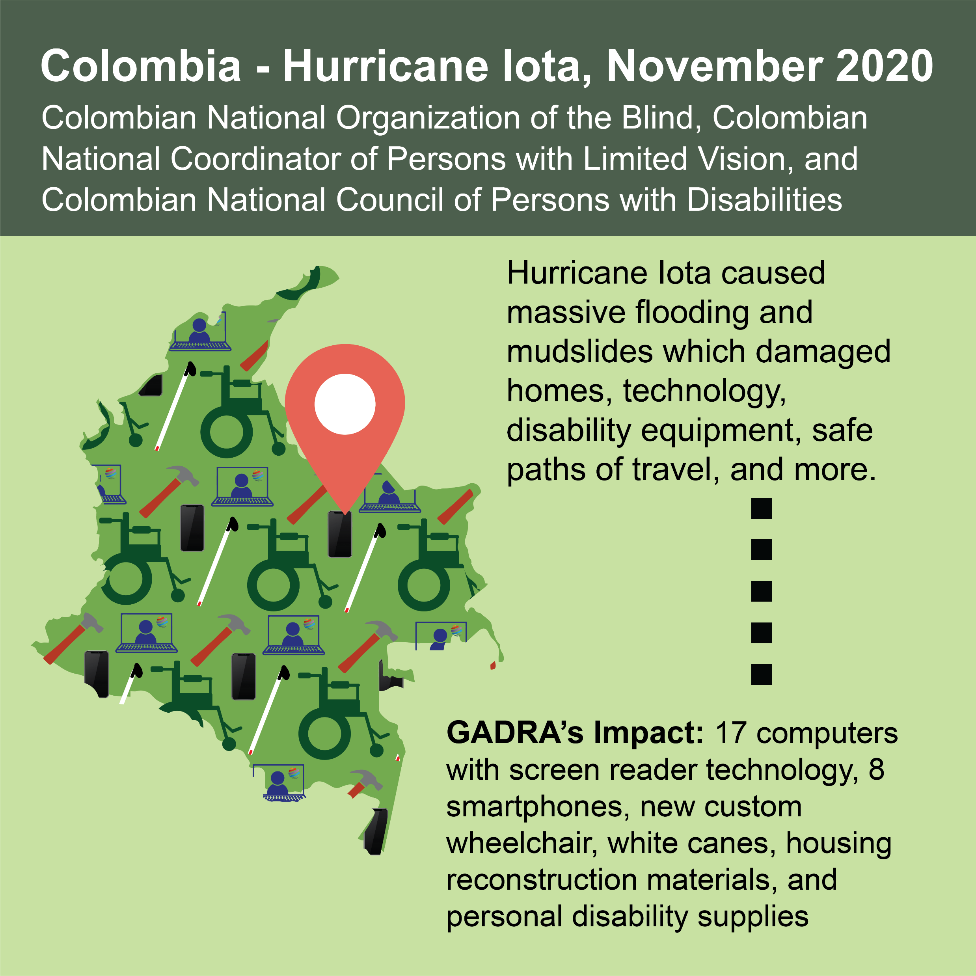
Hurricane Iota in Colombia
Replaced:
Computers with screen reader technology
Smartphones
White canes
Personal disability supplies
Housing materials
A custom wheelchair

Slide 5
Movimiento para el Alcance de Vida Independent Movement for the Reach of Independent Living (MAVI)
Hurricane Isaias in Puerto Rico

Slide 6
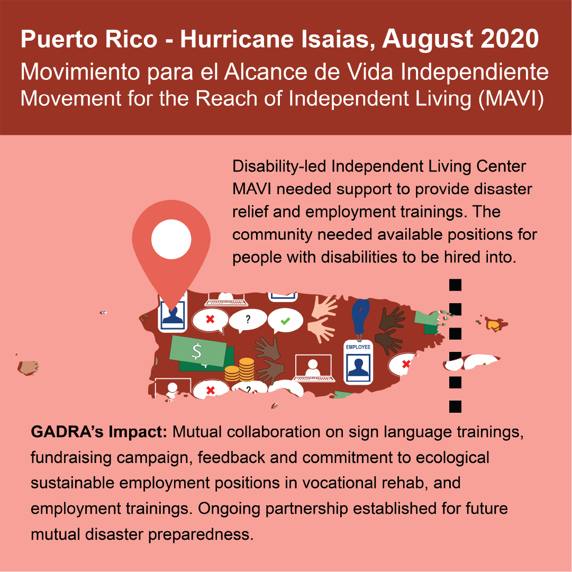
Hurricane Isais in Puerto Rico
Sign language trainings
Fundraising campaigns
Employment training
Established ongoing partnership for future disaster preparedness

Slide 7
Association á l’Intégration des Personnes Handicapées (ASSIPHA)
Earthquake in Haiti

Slide 8
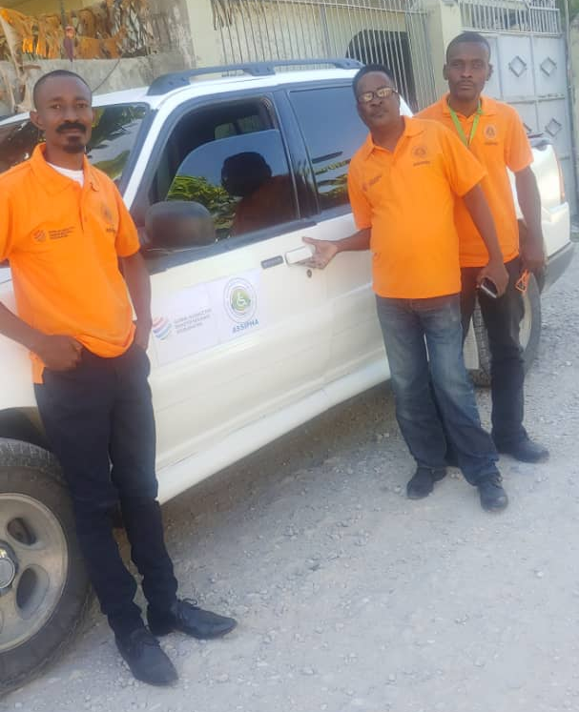
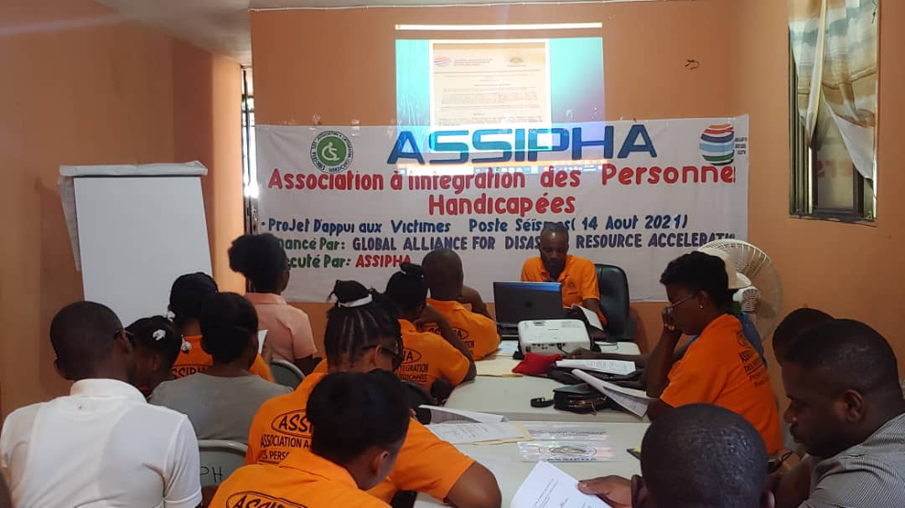
Earthquake in Haiti
Legal support to re-establish their operational structure
Essential needs (food, water, disability supplies)
Transportation to connect with Haitians in rural areas
Disability-inclusive emergency preparedness program to improve sustainability

Slide 9
Fight For Right (FFR)
Russian Invasion of Ukraine

Slide 10
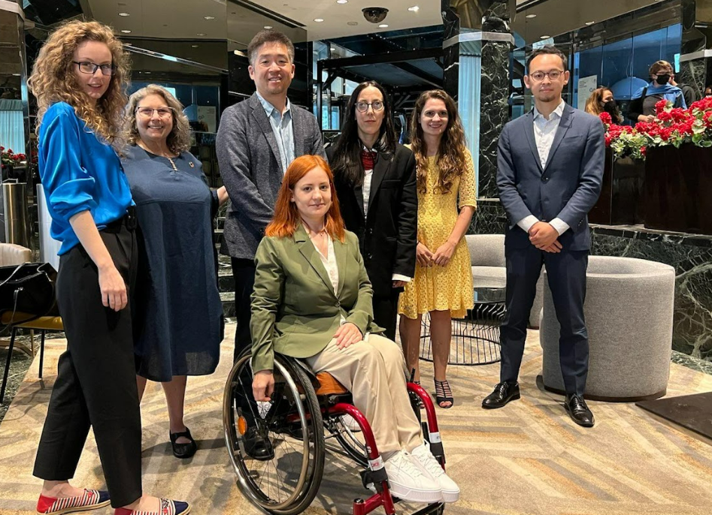
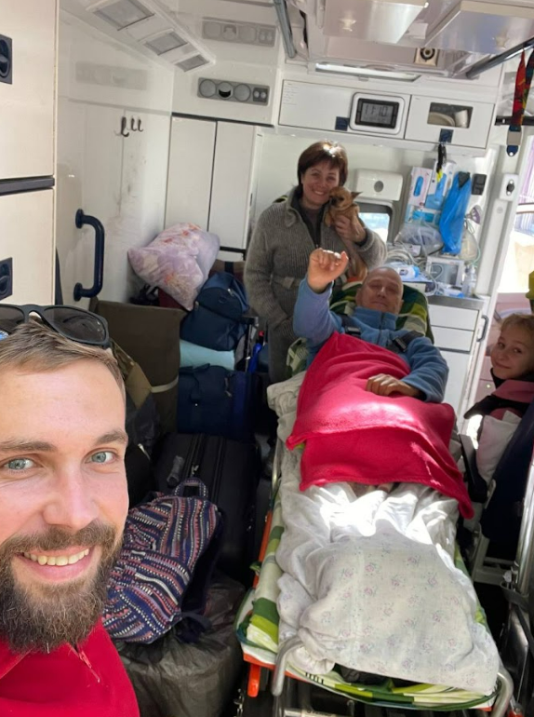
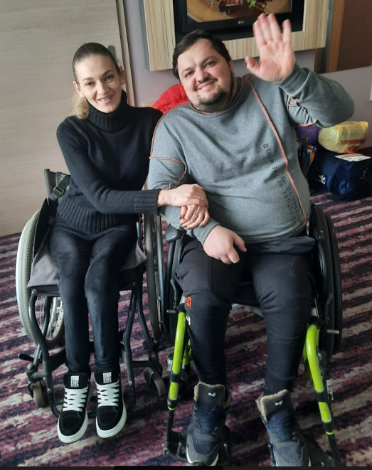
Russian Invasion of Ukraine
Problem solving re: war-time banking
Case management services
Medical evacuations
Medications, food, and water
Warming equipment and supplies for winter
Accessible housing
Connections to community supports
Working to highlight deinstitutionalization for all Ukrainians
Advocacy towards inclusive humanitarian aid on a global platform

Slide 11
Association of Women with Disabilities (Türkiye) and Almostakabal Association for the Physically Disabled (Aleppo, Syria)
Earthquakes in Türkiye and Syria

Slide 12
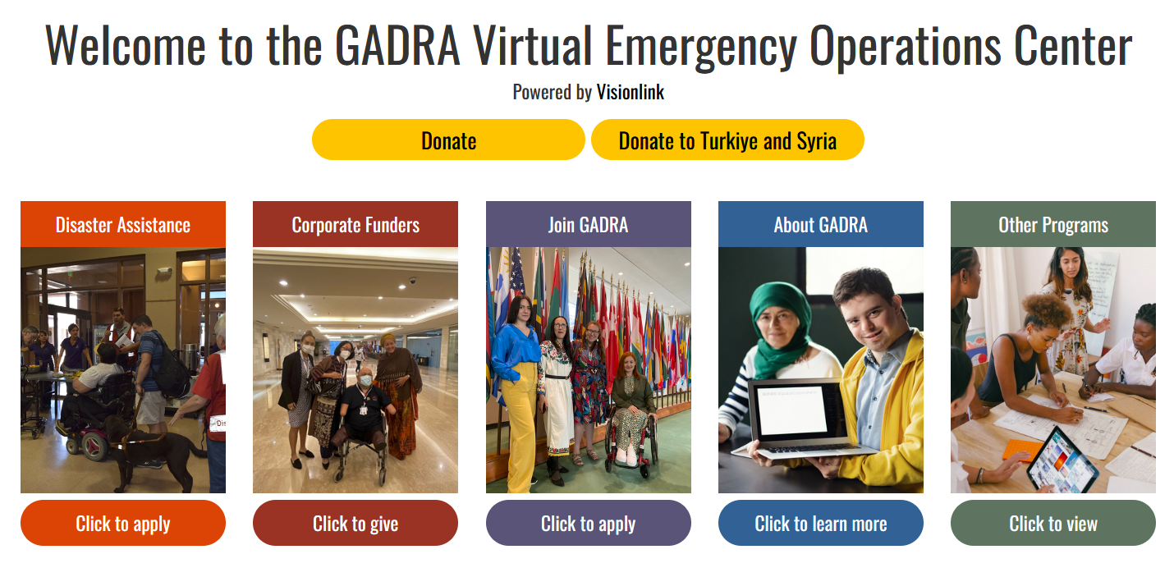
GADRA Virtual Emergency Operations Center (EOC)
https://gadra.communityos.org/

