Slide 1
Public-Private Health Equity Cooperative

Slide 2
Welcome and Introductions

Slide 3
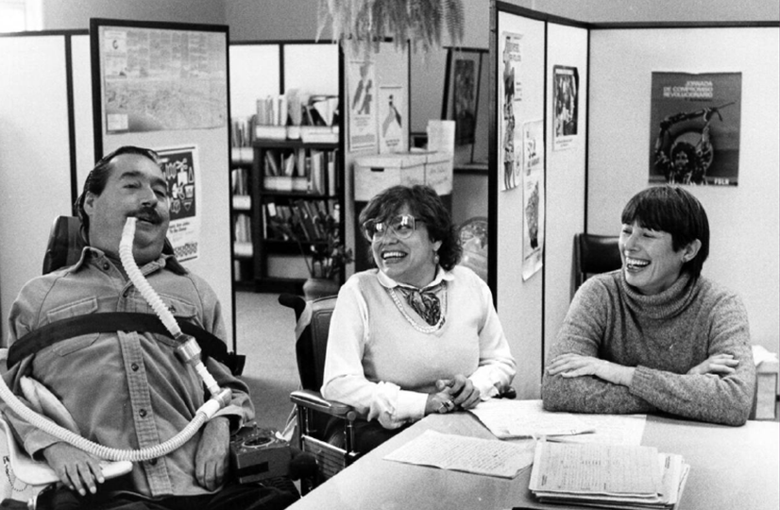
WID
WID Mission
To continuously advance the rights and opportunities of more than one billion people with disabilities globally with the design and delivery of whole community solutions.
Disaster Division Vision
Global leaders in disability inclusive emergency and disaster preparedness applying lived experience and relevant knowledge to real world challenges.
Notes:
Oldest consistently disability-led organizations in the US – founded by Judy Heumann, Ed Roberts, and Joan Leon – considered to be the parents of the ADA and disability rights movement

Slide 4
WID Project Team Introductions
Dawn Skaggs
Christina Alfaro
Natali Perilo
Dee Grimm RN, JD

Slide 5
Participant Introductions
Task Force Jurisdiction Participants

Slide 6
Background and Goals

Slide 7
Project Background
People with disabilities are 2 to 4 times more likely to have negative and disproportionately poorer outcomes in disasters, and are least likely to return to their baseline state of health after disasters
Marginalized and multiply marginalized populations are documented to have the most significant negative disaster impact, indicating that they have the least amount of resiliency prior to a disaster
Systemic and institutional policies exist that are biased and discriminate against certain populations (social determinants of health)
Disability crosses all other social and community sectors and is the only bias that has not had significant improvement in the last 15 years

Slide 8
Premise for the Project
Prejudices, biases or judgmental thinking may affect how resources are allocated and how certain people are treated in disasters
Previous experiences and mistrust between marginalized populations make emergency planning and messaging more complex
Some populations may require more assistance during disasters to maintain their health and independence that may be insufficient or unavailable
All disasters start at the local level, so solutions need to start at the local level
Health equity in disasters does not happen in a silo – it is dependent on community partnerships

Slide 9
The Project

Slide 10
Project Overview
Goal 1: Improve health outcomes for people with disabilities and other intersectional marginalized groups before, during and after disasters
Goal 2: Improve community disaster programs and services for people with disabilities and other intersectional marginalized groups

Slide 11
Project Objectives
Foster Community Health Resilience
Engage representatives in dialogue to strengthen preparedness for, response to, and recovery from disasters and other emergencies
Identify and promote promising practices
Provide technical assistance to Public Health, Healthcare, Emergency Management Communities, and invested community stakeholders

Slide 12
Project Outcomes for People
Decrease disparities in health outcomes at the local level for people with disabilities and other intersectional marginalized groups during disasters.
Create partnerships with local community associates (health departments, public agencies and private sector) to improve outcomes in disasters for people with disabilities and other intersectional marginalized populations.
Improve inclusionary practices and policies in public health emergency operations plans for people with disabilities and other intersectional marginalized groups.

Slide 13
Project Steps
Identify pilot jurisdictions and invite them to participate in project
Identify potential task force participants and send invitations
Set regular task force meetings with WID facilitation
Perform community health assessment related to disasters
Perform root cause analysis of community health disparities
Develop action plan to improve health outcomes
Implement community level health strategies for improving outcomes and reducing disparities
Document project outcomes for national recommendations and utilization

Slide 14
The Task Force

Slide 15
Task Force Diversity
Task Force must represent a diverse array of community stakeholders
Racially, ethnically, and culturally diverse
Socio-economically diverse
Geographic diversity of the region
Diverse community roles
Diverse experiences and perspectives

Slide 16
Potential Task Force Make up
Emergency managers
Healthcare and public health services
Policy leaders
NGOs, Businesses, Private sector partners
Disability-led organizations
Community-based services and organizations
Informal community leaders (faith-based organizations, cultural leaders)
Tribal nations
Educational institutions/providers
Disability stakeholders

Slide 17
Disability Stakeholder Representation
Identifying disability representation by diverse functional needs:
Mobility
Vision
Hearing
Cognitive, intellectual and developmental disabilities, mental health illnesses
Accounting for dynamics of intersectionality of other marginalized populations to ensure pan-disability representation

Slide 18
The Task Force POC

Slide 19
Task Force POC Role
Review project process and Task Force overview prior to first meeting
Assist to identify, invite and confirm task force participants (flyer and information will be provided)
Assist with Task Force meeting scheduling and logistics
Serve as the point of contact for Task Force communication
Serve as liaison for community regarding the Task Force activities
Provide project team with any inquiries about the project and requests for accommodations

Slide 20
Task Force POC Role Continued
Assist Task Force members with distribution of community assessments, surveys and demographic studies
Encourage task force members participate regularly in meetings, discussions, collaboration, and information dissemination
Communicate task force needs, challenges and requests to project team
Identify replacement POC if unable to remain in the role

Slide 21
Resources
Project Manager:
Dawn Skaggs dawn@wid.org
Task Force Facilitators:
Dee Grimm emctrainer@aol.com
Natali Perilo natali@wid.org
Project Coordinator:
Christina Alfaro christina@wid.org

Slide 22
Questions and Discussion
World Institute on Disability | www.wid.org | © 2023 WID. All rights reserved.

